Slide 1
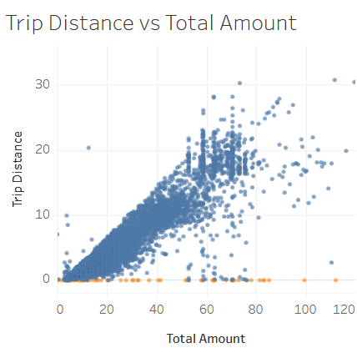
EDA of yellow taxi trip data
A detailed analysis of the yellow taxi trip data
Project Overview
An EDA was performed on the yellow taxi trip data to investigate the different variables and identify any potential data issues to address before proceeding with the modelling step.
The dataset contains the key variables that are relevant for modelling the taxi fare amount
The dataset contains no missing values, nor duplicates
Some potential data issues were identified:
148 trip distances with amount 0
20 negative or 0 fare amounts
33 records with passenger count of 0
One extreme fare amount
All records with RateCodeID 2 have the same fare amount (is that justified?)
The fare amount is positively correlated with the trip distance
The tip amount is not influenced by the vendor or passenger count
The number of rides changes over the months and the days of week (Wednesday to Friday are the busiest)
The sum of all total fare amounts is highest on Thursday
The figure above shows the relationship between the trip distance and total fare amount. The points in orange correspond to records where the trip distance is 0, but the total amount is a positive number.
The records that contain potential issues should be removed before proceeding with the modelling step.
The reason why the records with RateCodeID 2 have all the same fare amount should be investigated further before deciding whether to keep them or not.
Once that is done, a data filtering step can be implemented to generate the dataset that is ready for modelling.

